Slide 1


Slide 2
Project:
HEALTHTRACKER
Developers/Designers :
Archit Agrawal (FrontEnd Developer)
(1900270130043)
Ayush Khandelwal (Backend Developer)
(1900270130053)
Leaded By :
Mr. Lucknesh Kumar

Slide 3
Introduction
HealthTracker will provide health check using BMI and will suggest a healthy diet.
Calories intake, recipe of healthy foods to keep yourself fit which is key to live a long life.

Slide 4
Result
We have already covered the feasibility, ideas behind project, functioning, tools and other requirements data in previous presentation.
As expected our project is completed successfully within stipulated time.
In this presentation we are presenting some screenshots showing some demo and give you an idea that how our project is looking and working.

Slide 5
Screenshots attached :
User Login Recipe Corner
User Signup Particular Recipe
Storage in database Contact Page
Homepage
Chatbot
Overweight/Underweight /Normal/Obese Pages
Note: Screenshots quality are reduced. So. avoid quality. Screenshot for complete page are attached as some extra pictures at last.
Responsivity Dropdown (Navbar)
BMI calculator Calorie Tables
About

Slide 6
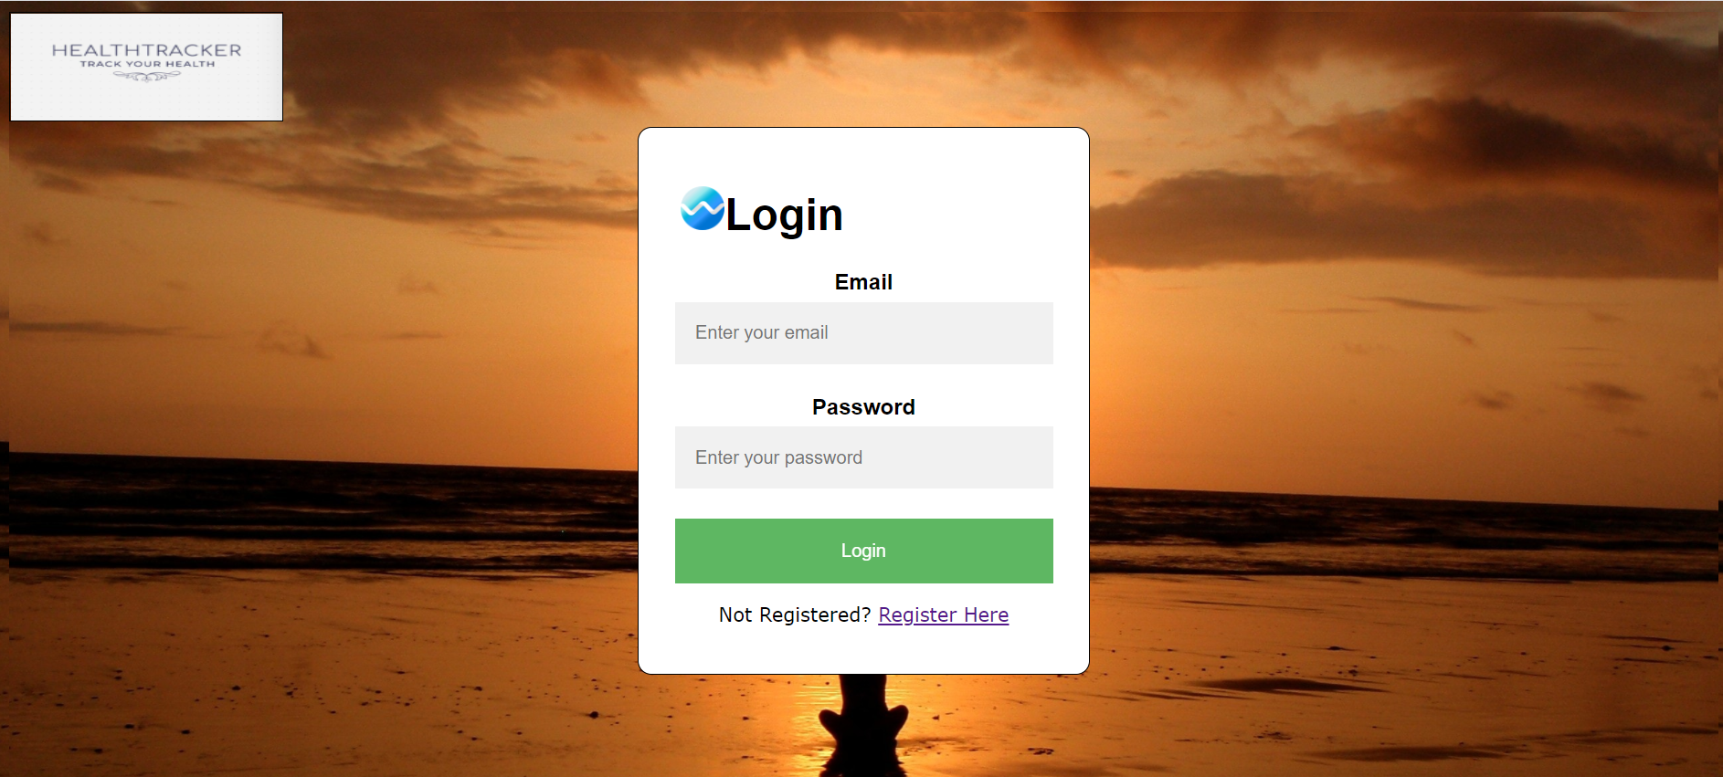
Login Page:
Page where existing users will login.
User are required to enter their previously registered email id and password.

Slide 7
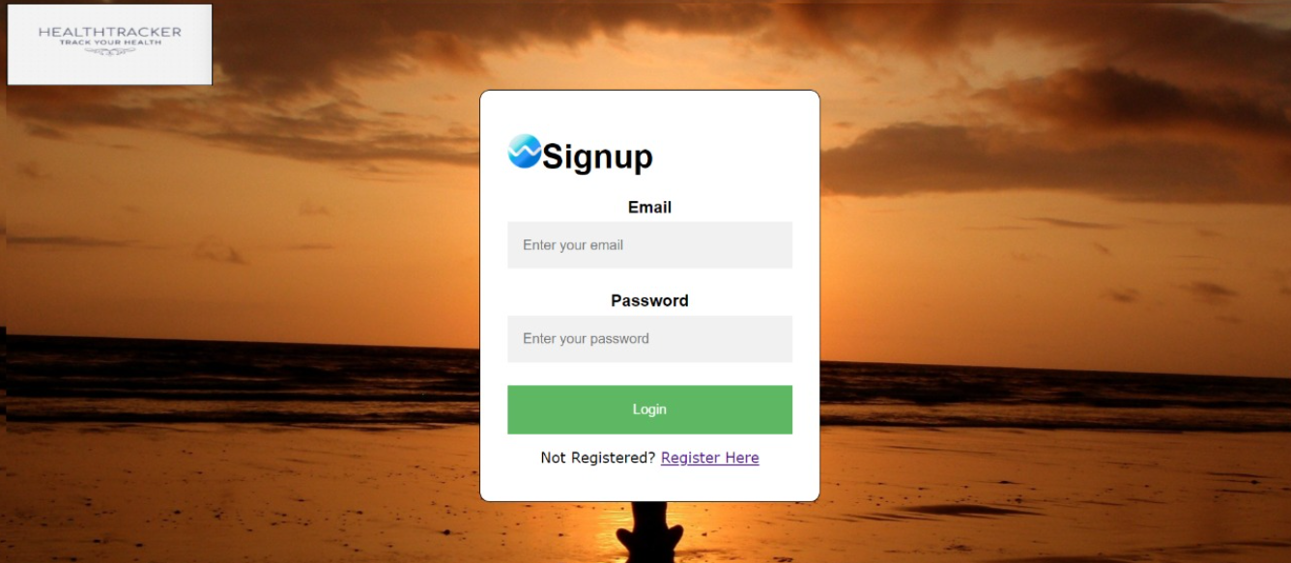
Signup Page:
Page where new users will make them registerd user.
If they are already registerd they may redirect to login also.

Slide 8
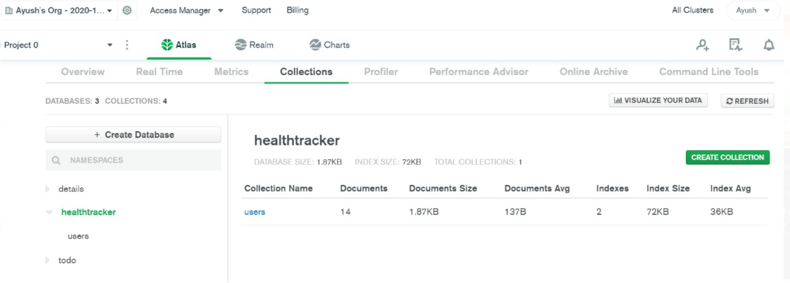
Screenshot of database created in mongoDB

Slide 9
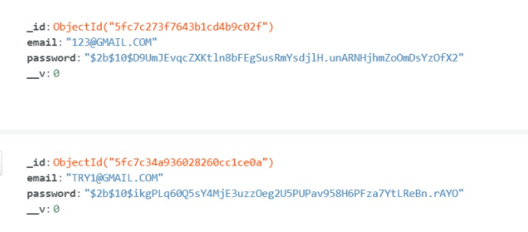
Screenshot of data storing in healthtracker database

Slide 10
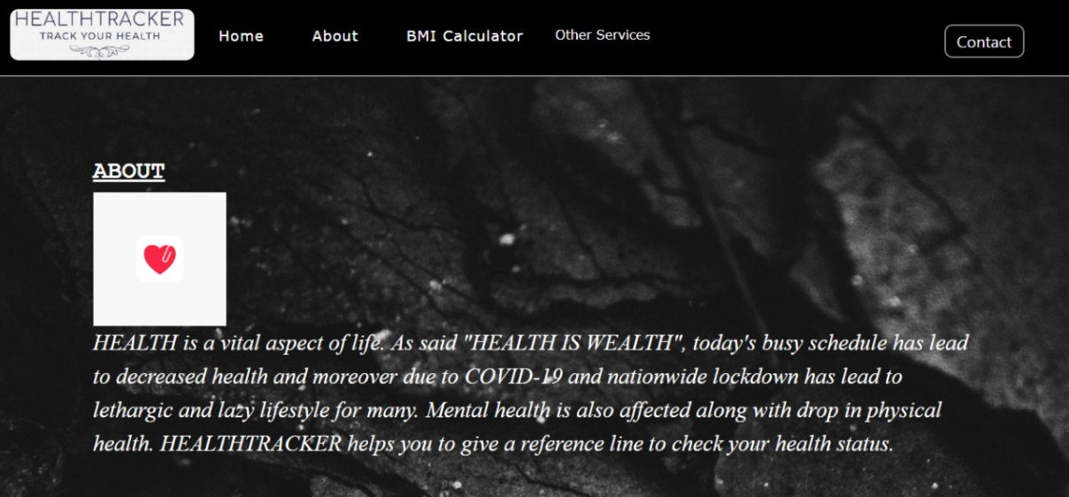
Homepage:
First page where user will come after successfully logged in.
It will consist of dropdown menu which will be key to access our full project.

Slide 11
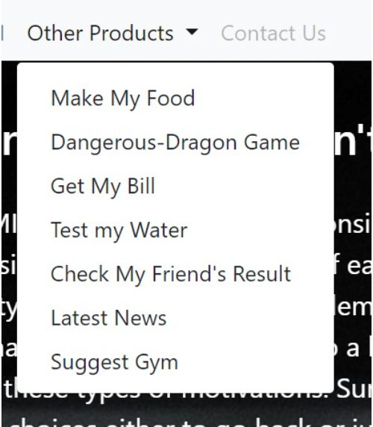
DropDown Menu
It will allow user to move to the products that HEALTHTRACKER contains.

Slide 12
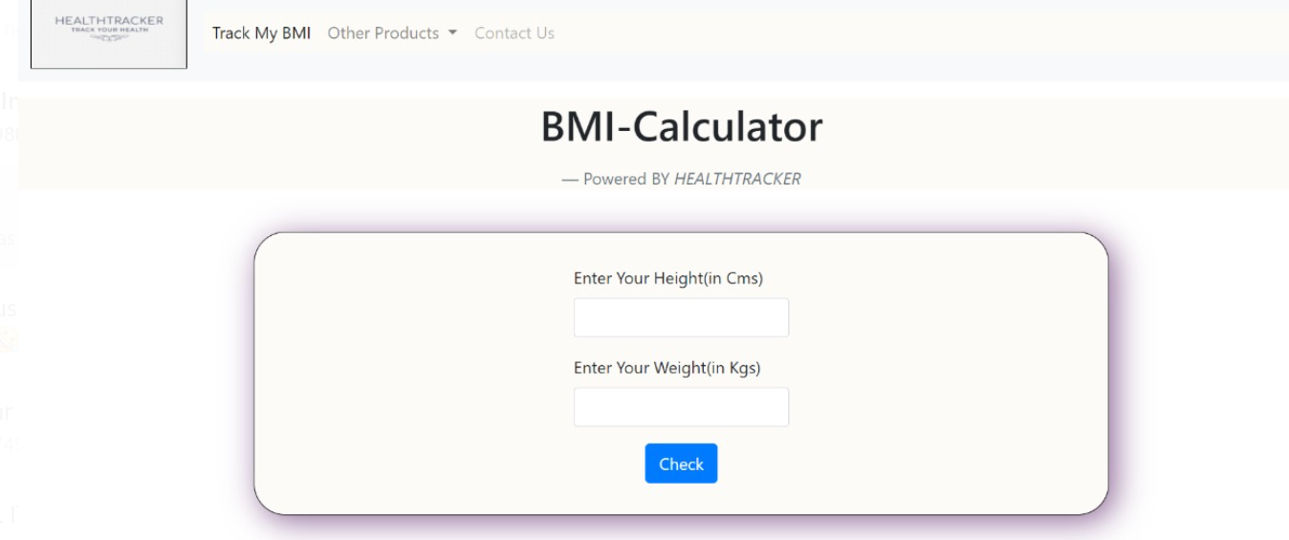
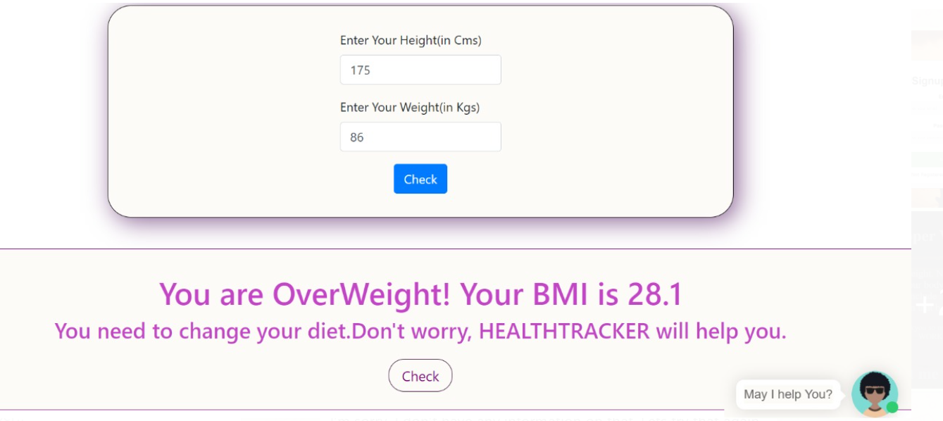
BMI calculator

Slide 13
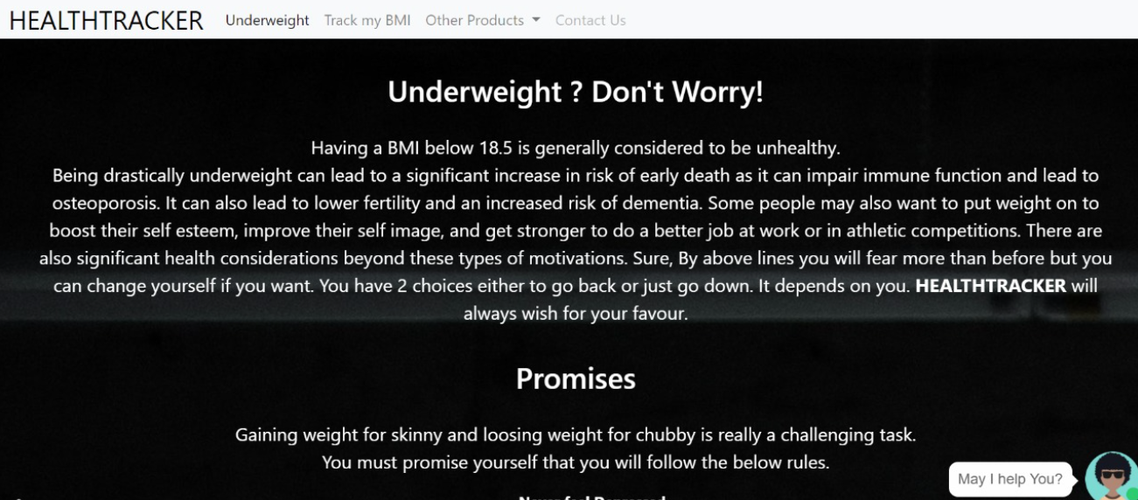
Underweight/Overweight/Normal/Obese pages will be shown to user.

Slide 14
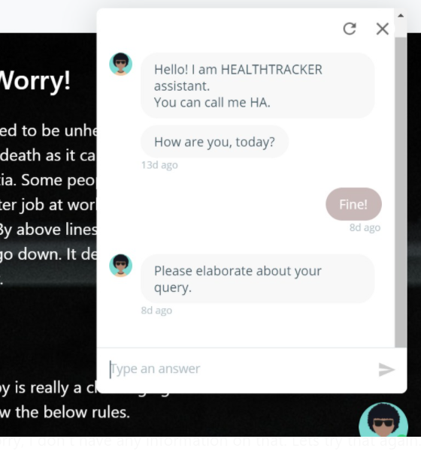
Chatbot:

Slide 15
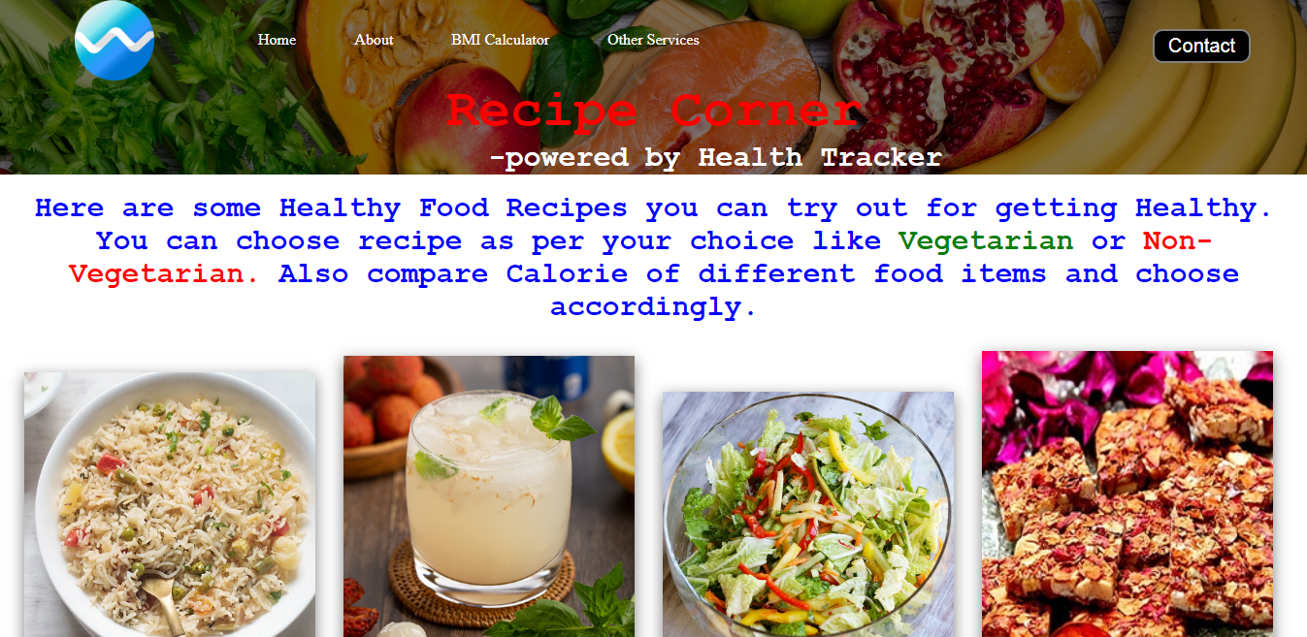
Recipe Corner

Slide 16
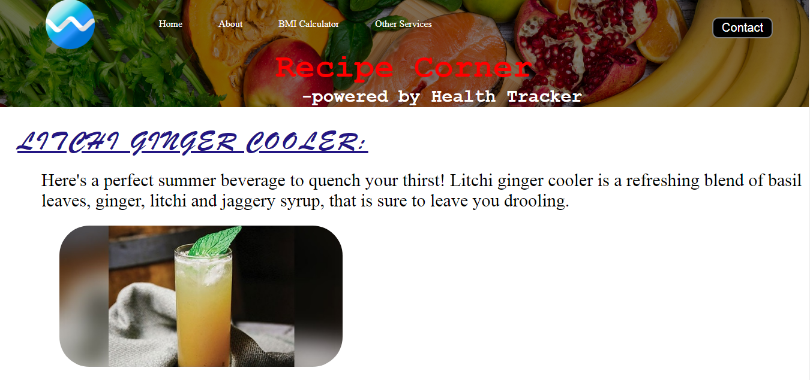
Particular Recipe Page

Slide 17
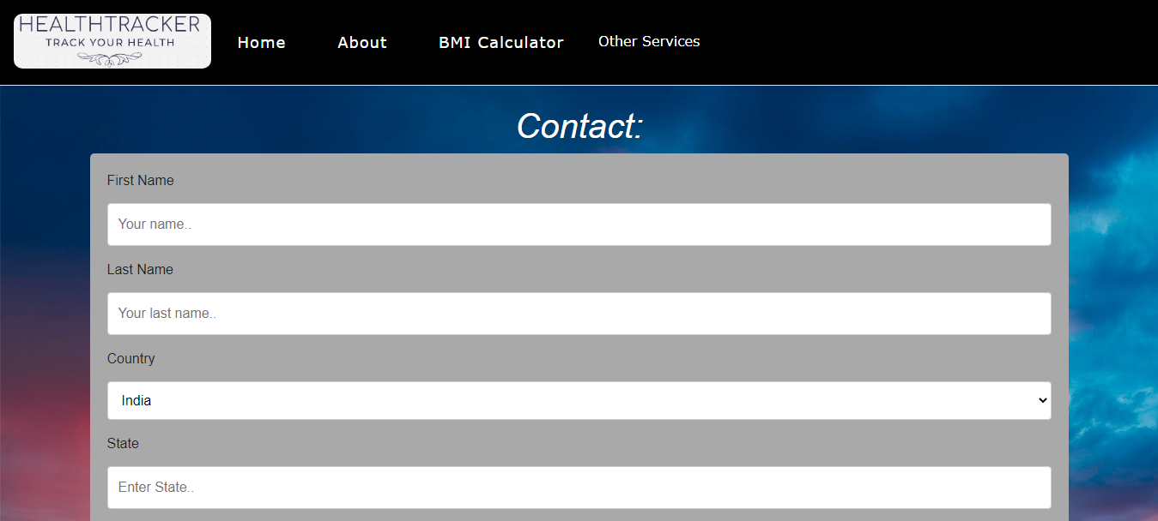
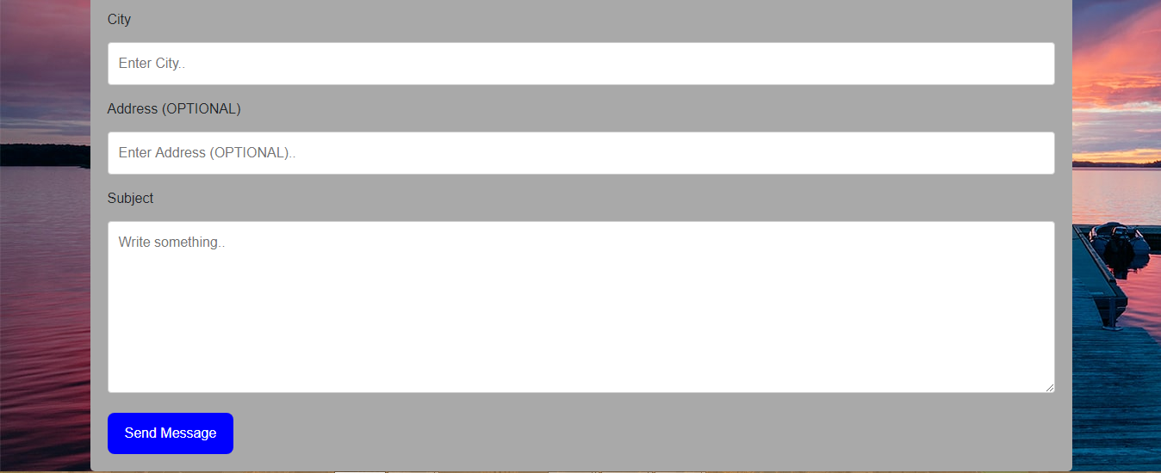
Contact Page

Slide 18
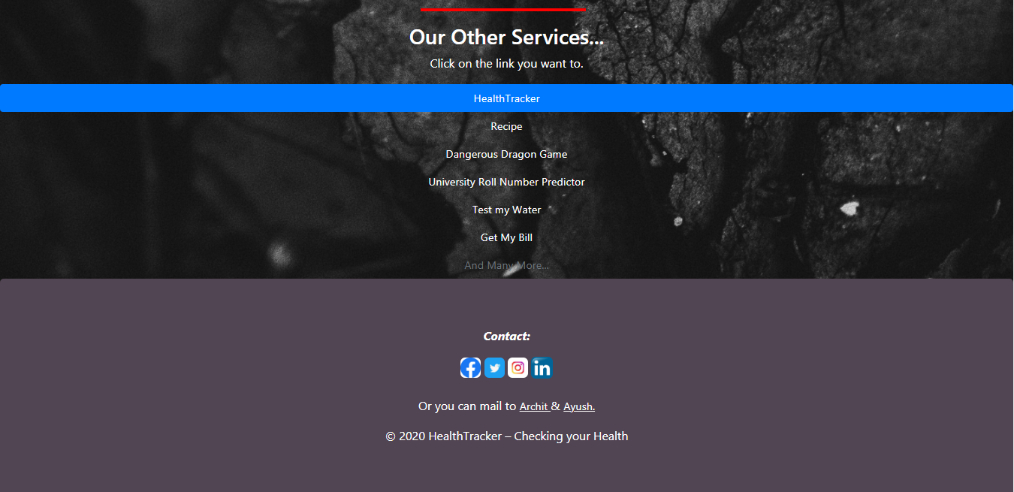
Footer

Slide 19
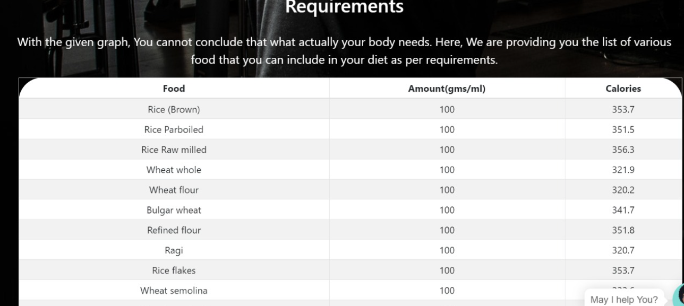
Calorie Table

Slide 20

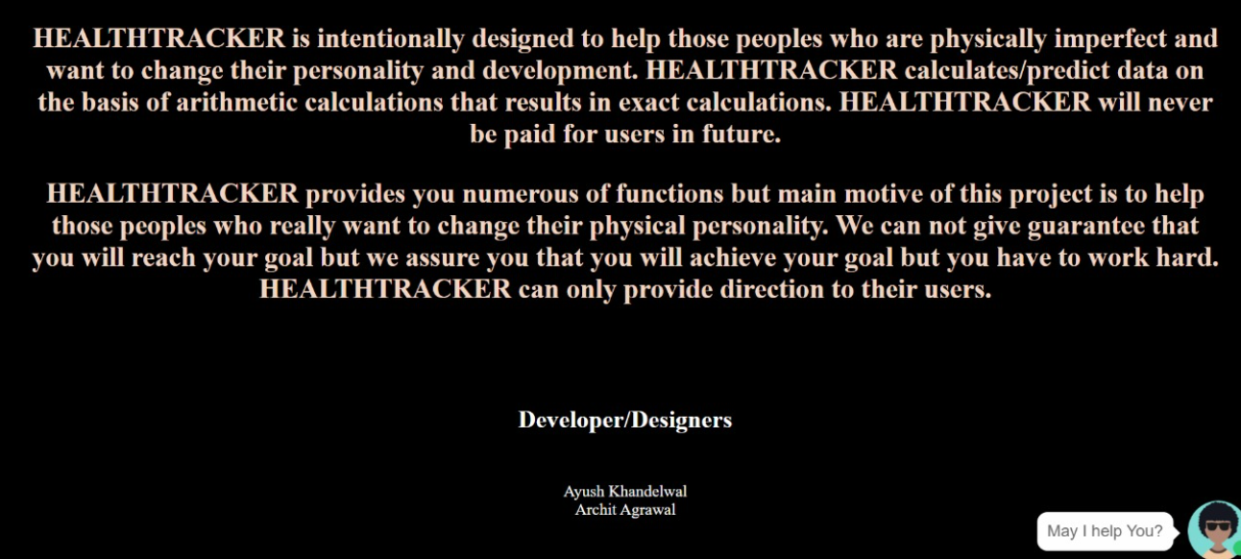
About Page

Slide 21
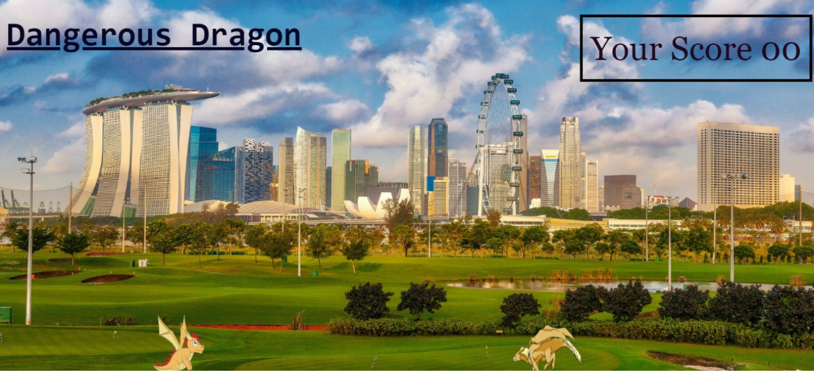
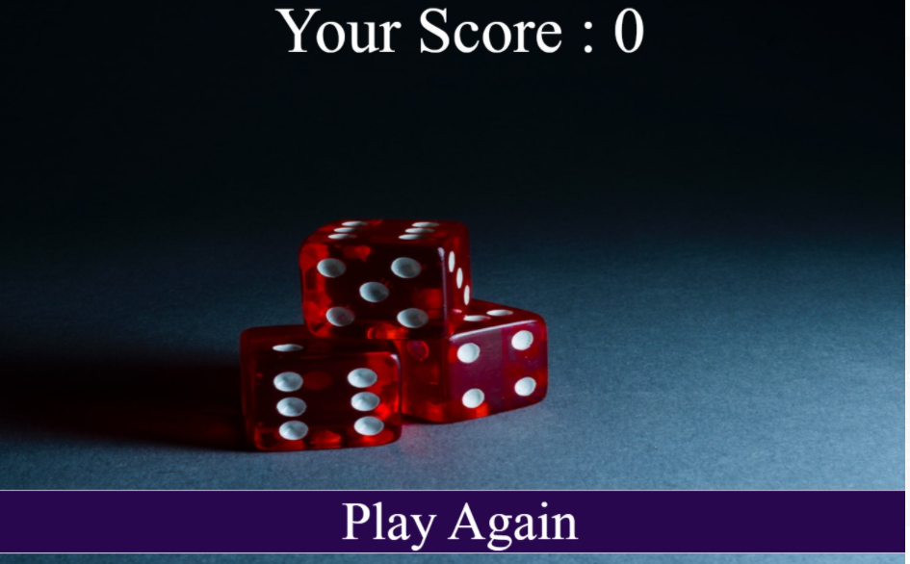
Game: Dangerous Dragon

Slide 22
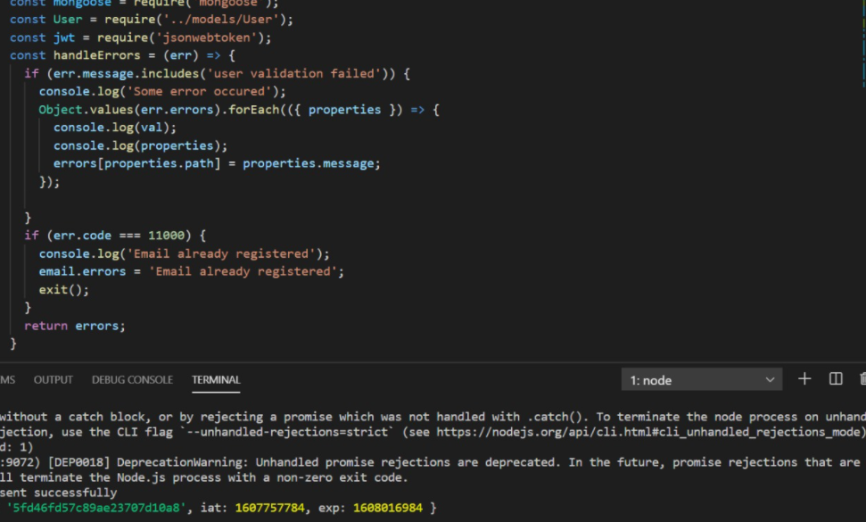
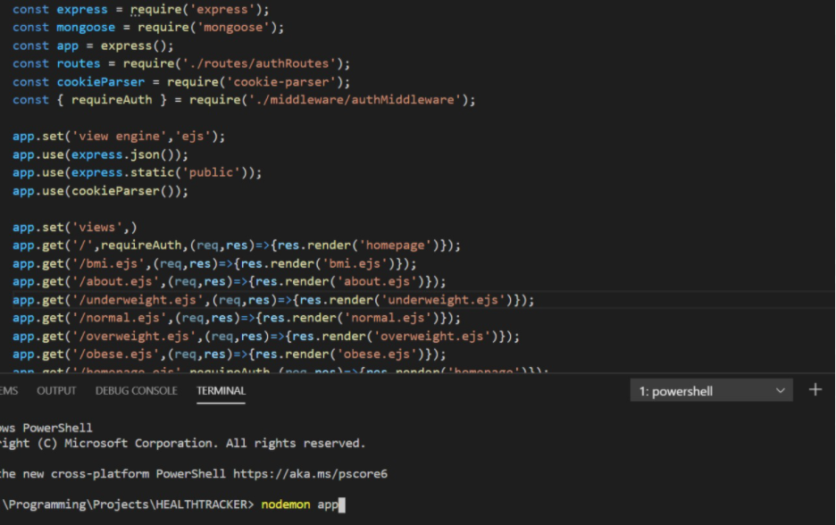
Some Random Codes

Slide 23
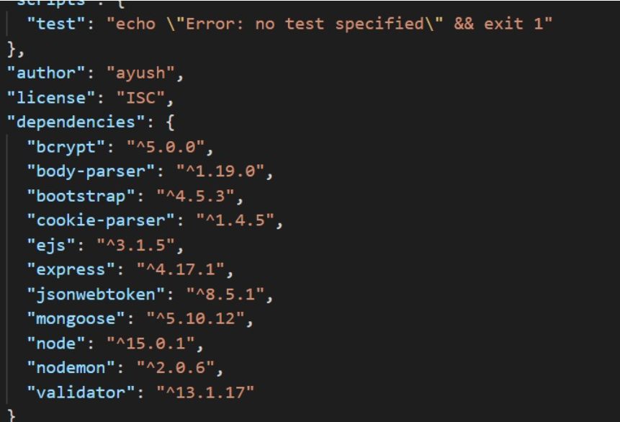
Third Party Packages Used:

Slide 24
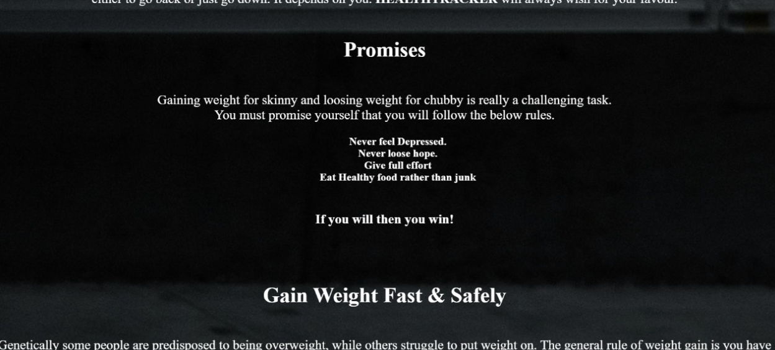
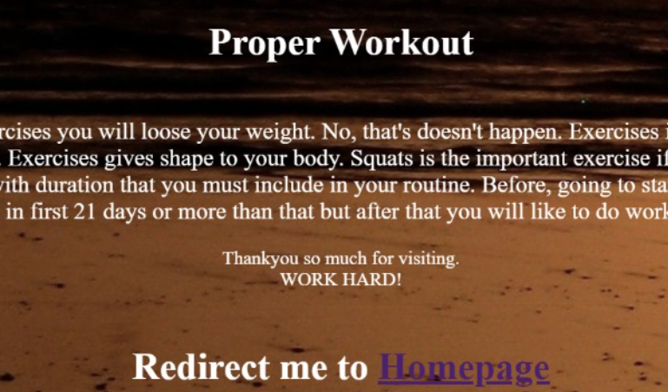
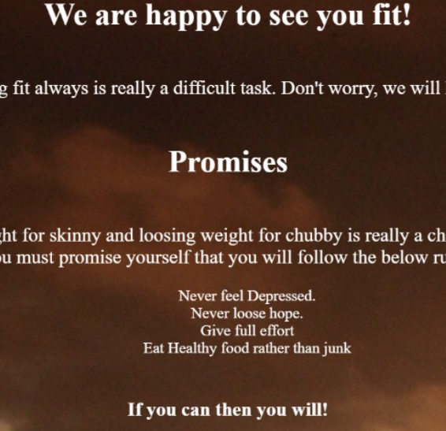
Some More Screenshots

Slide 25
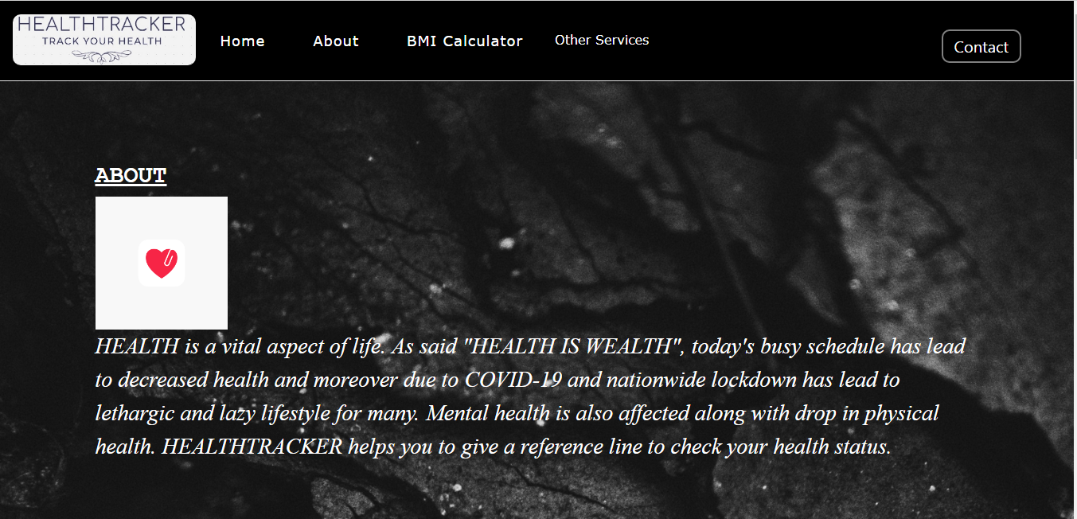
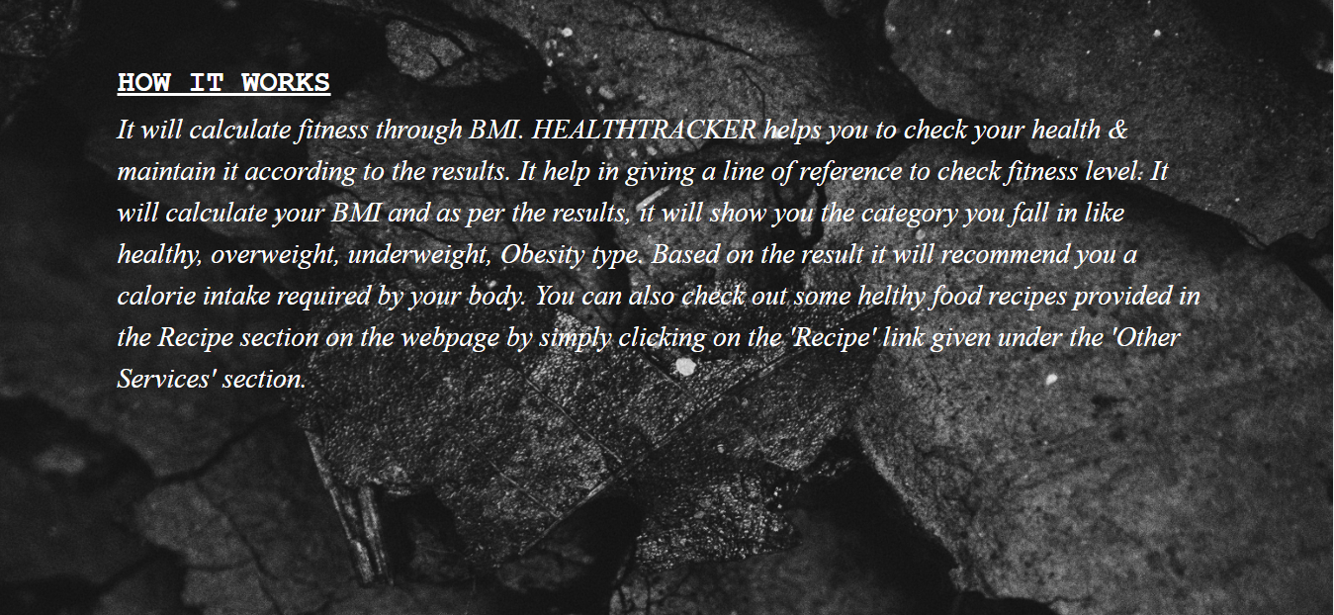
Homepage

Slide 26
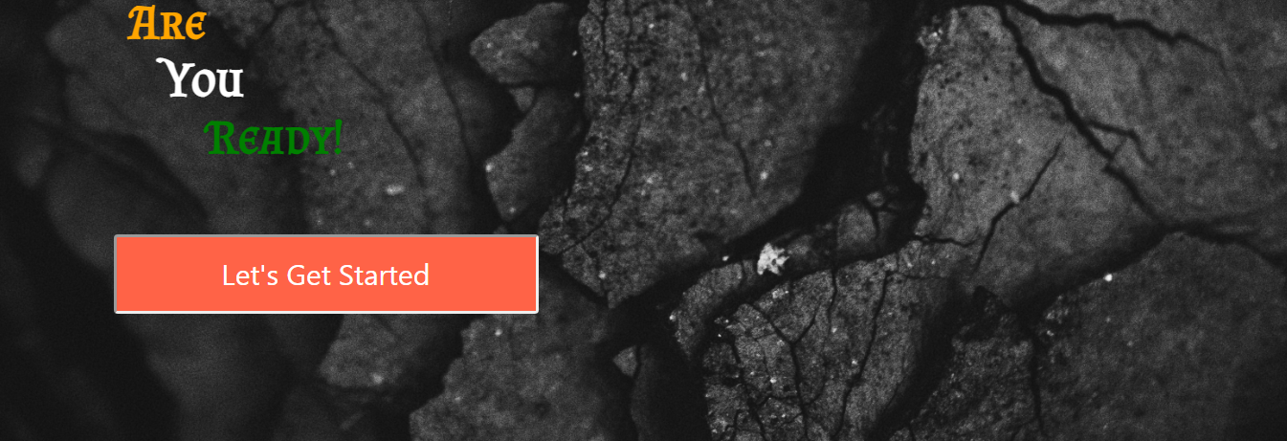

Slide 27
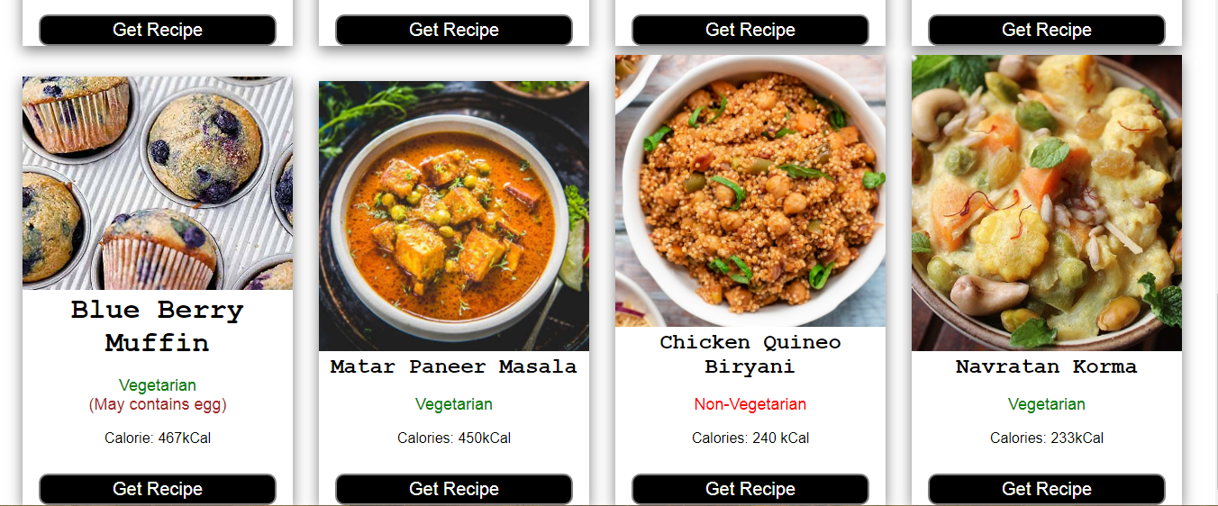
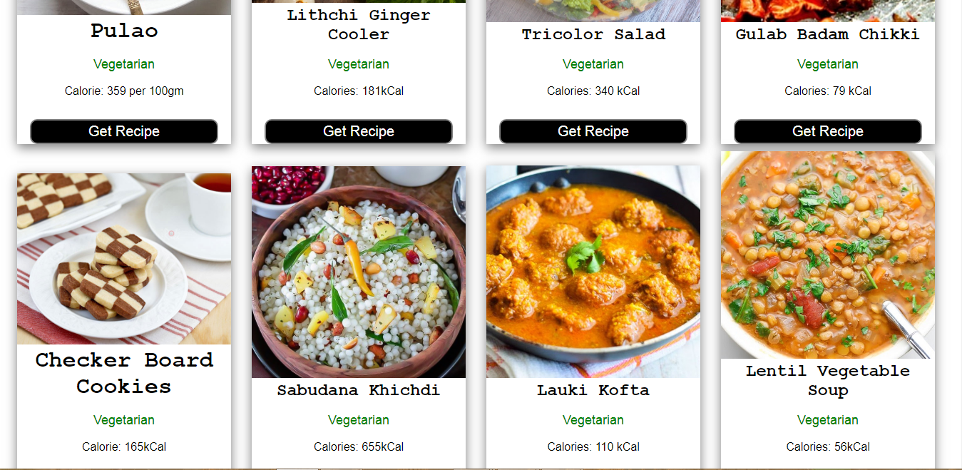
Recipe page

Slide 28
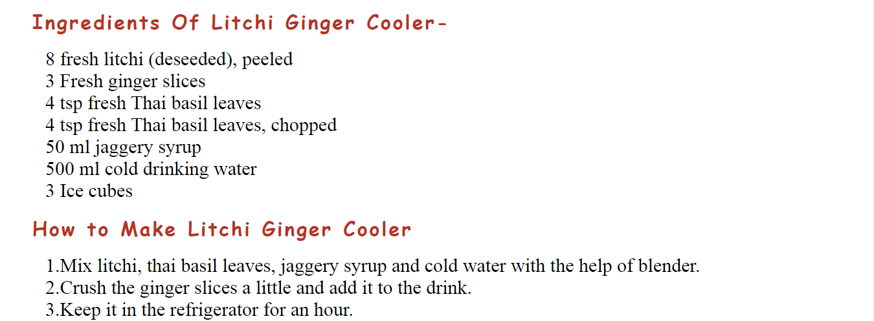
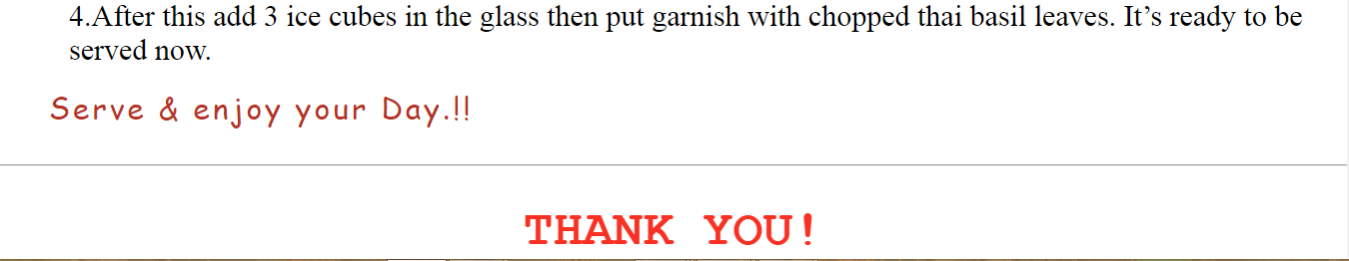
Particular recipe page
(as example)

Slide 29


Slide 30
Thank You

